Slide 1
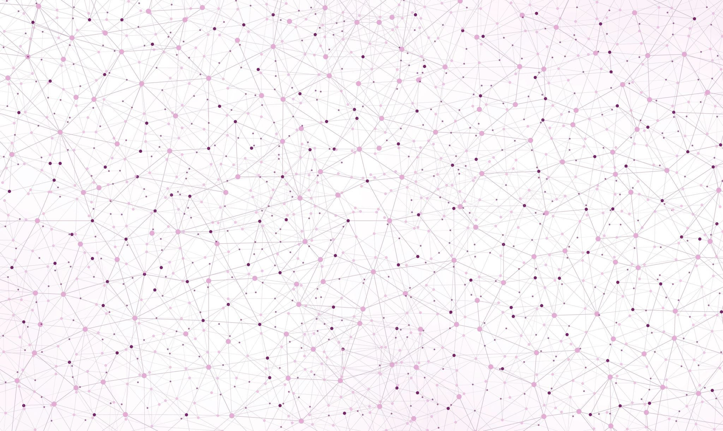

Drawing and shading basic geometric forms
HOW TO CREATE VALUE, USE LIGHT SOURCE AND MAKE A 3D EFFECT WITH SHADING AND HATCHING TECHNIQUES

Slide 2
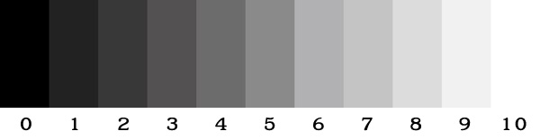
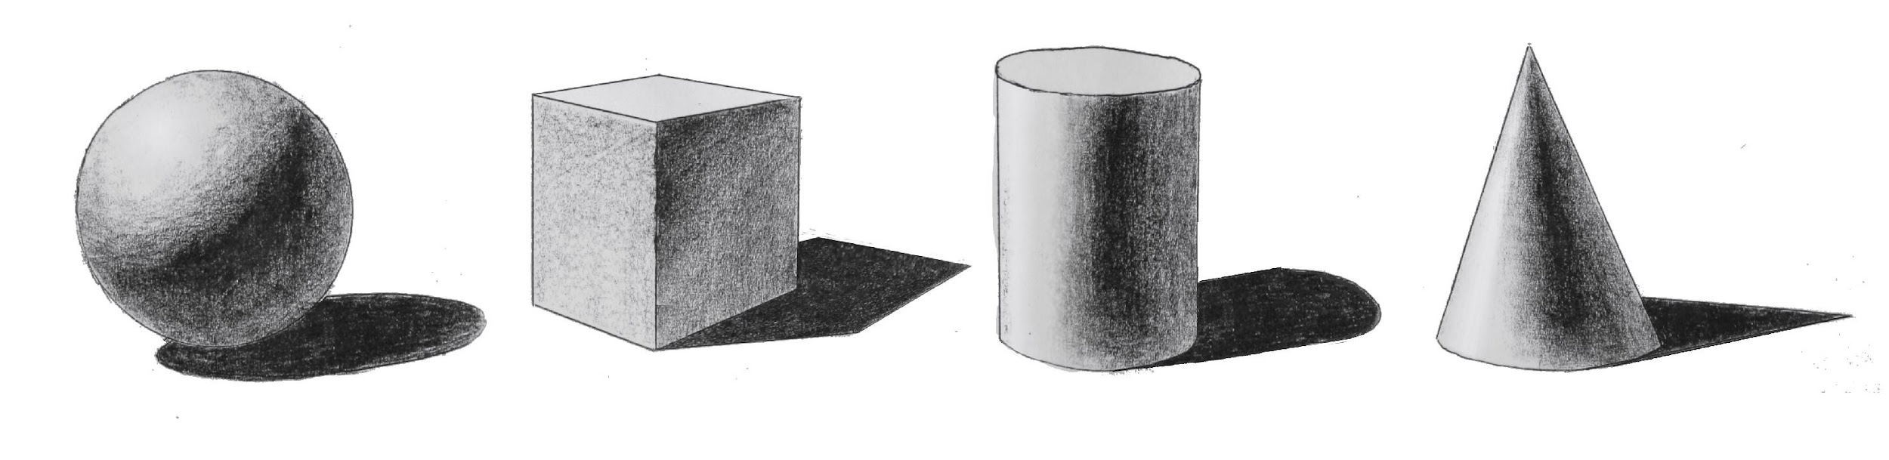
What are values in tonal drawing?
Value, in painting and drawing, means how light or dark a color is. Every color can create a variety of values.
A grayscale, or value scale, is the sequence of tones from light to dark that can be made between white and black—the lightest and the darkest grayscale tones.
Artwork that utilizes only the mid-tones—or the middle of the grayscale—are at risk of appearing flat and dull because of the lack of contrast. A successful artwork will have a pure white tone (or a highlight) and a pure black tone (a shadow) to give the work a full tonal range.

Slide 3
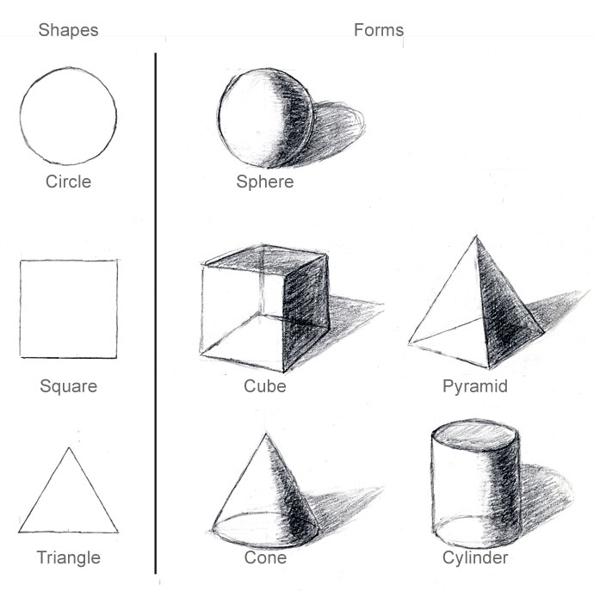
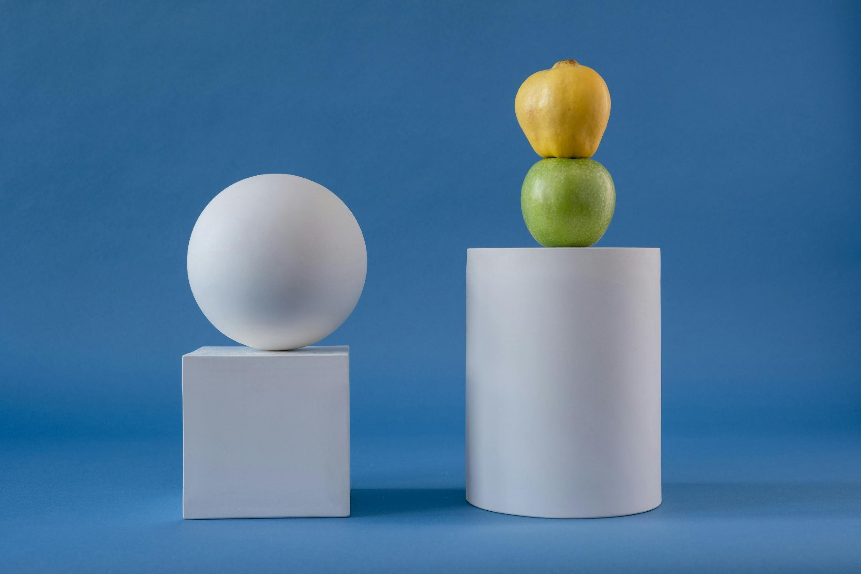
Values create a visual effect of depth and transform shapes into forms in our drawings
Photos by Marina Leonova, Mikhail Nilov and the cottonbro studio: www.pexels.com

Slide 4
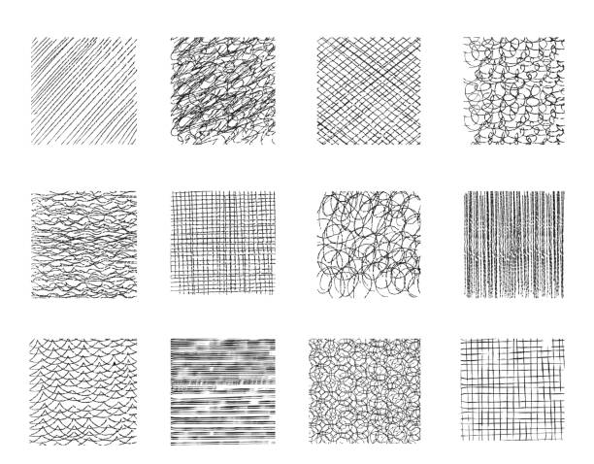
Create value with hatching
Hatching is a great way to create value with pen or pencil. Here are a few variations of fast and effective hatching technique.

Slide 5
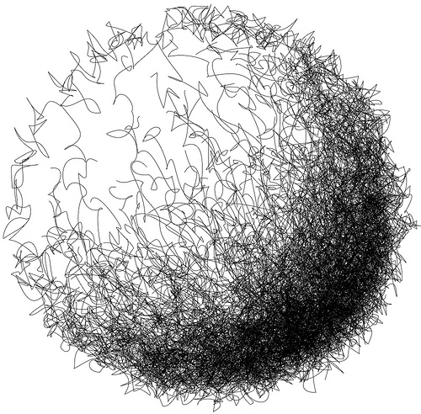
Scribble Hatching
Make sets if tiny overlapping circles or squiggles. This creates a rough, loose organic texture. To darken, add more squiggles over the squiggles. Blur your eyes to find areas of uneven value and fill these with additional marks.

Slide 6
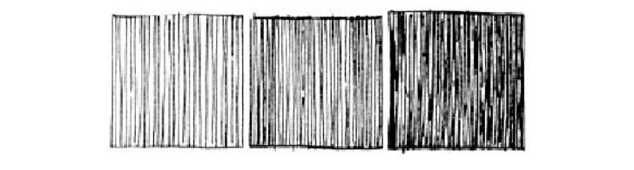
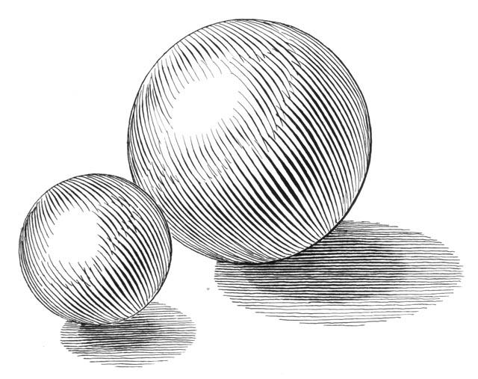
Parallel Hatching
You can use parallel lines to fill an area with tone. By varying the spacing and width (pressure) of the lines you can make areas darker or lighter. Use your non-photo blue pencil to add a few parallel lines before you start to help prevent your lines from drifting to a new angle across the hatched area.
If it will take multiple strokes to make a longer line, try leaving little irregular spaced gaps between one line and the next instead of overlapping the strokes. Overlap strokes often make irregular blotches while irregular spaced gaps add a little sparkle to your technique.
If your lines show through in your final drawing, their direction can help to show changes in the planes of the object you are drawing.

Slide 7
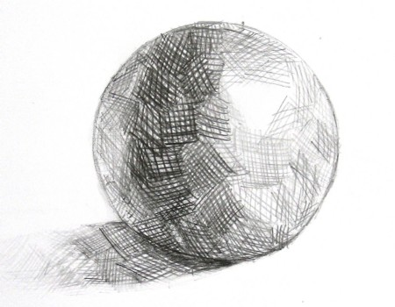
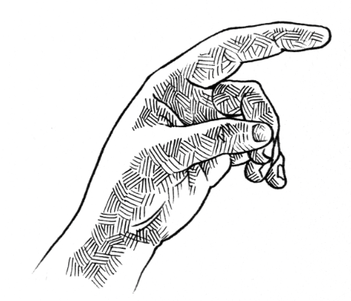
Patch Hatching
Can’t draw a straight line? Patch hatching is for you. This technique is very vast and creates a dynamic and interesting texture. Create small sets of interlocking lines, varying the angle of each set.

Slide 8
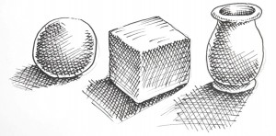
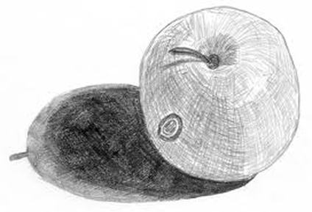
Cross-Hatching
Cross-hatching is a fundamental technique to deepen values. There are a few subtleties with this technique that are often overlooked. The most important is to watch the angles of the cross lines, avoiding right, and sharply acute angles.

Slide 9
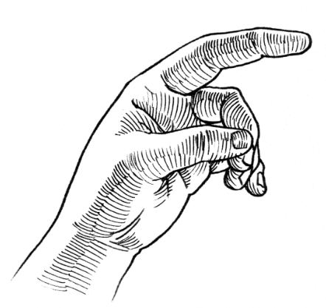
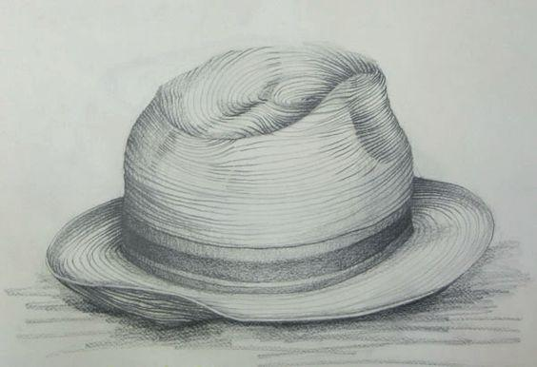
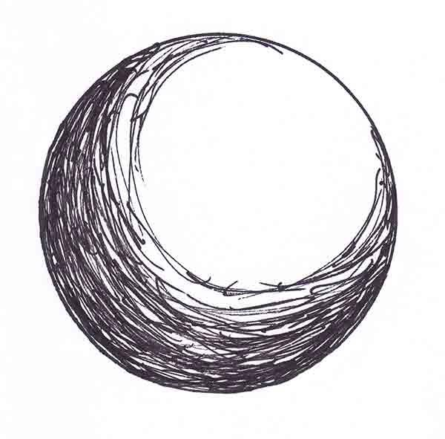
Contour Hatching
Instead of keeping the lines parallel, you can wrap them around a curved surface. As you draw, imagine the lines wrapping around the curved surface. The lines can fan out from a pinched shape to fill a larger area. As they do, the lines may become so spaced from one another that they no longer read as an area of tone but individual lines. Resolve this by making a second set of lines from the outside of the broad edge toward the narrow point. You can also crosshatch these contour lines.

Slide 10
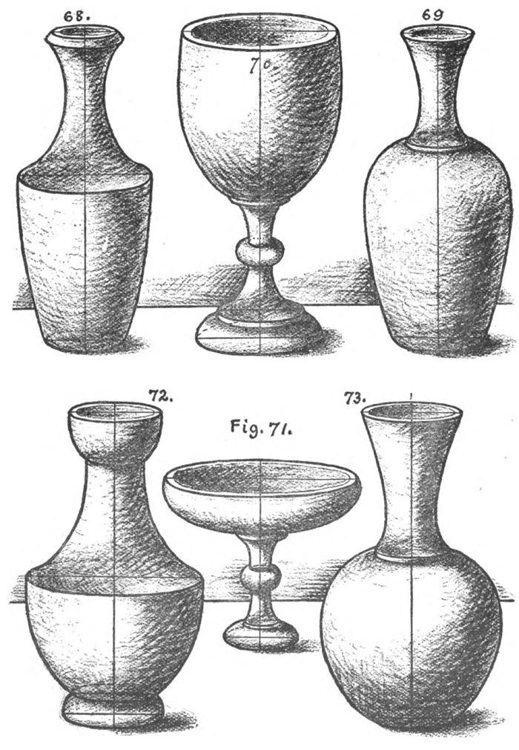

Drawing simple geometric still life objects using the hatching techniques

Slide 11
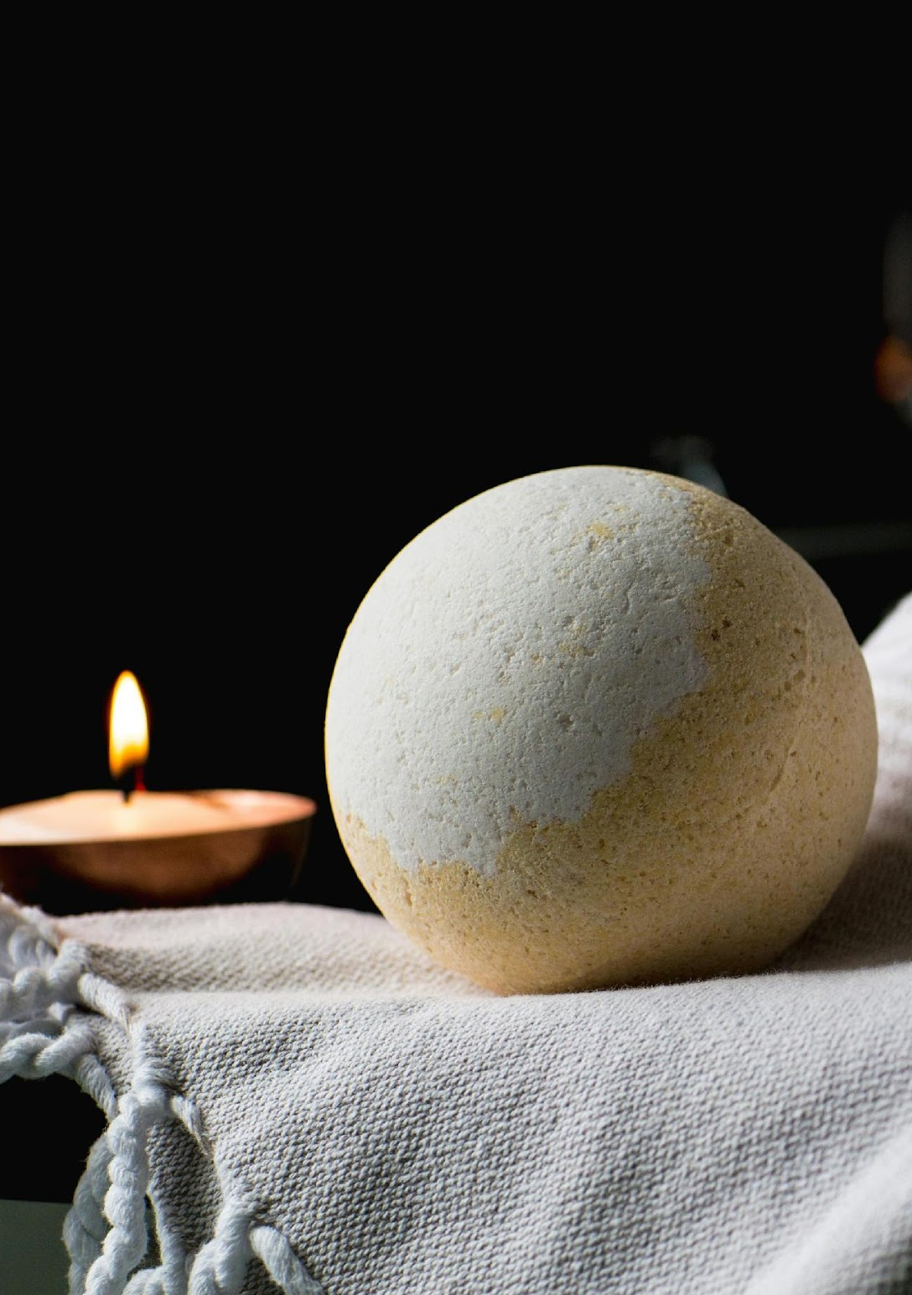
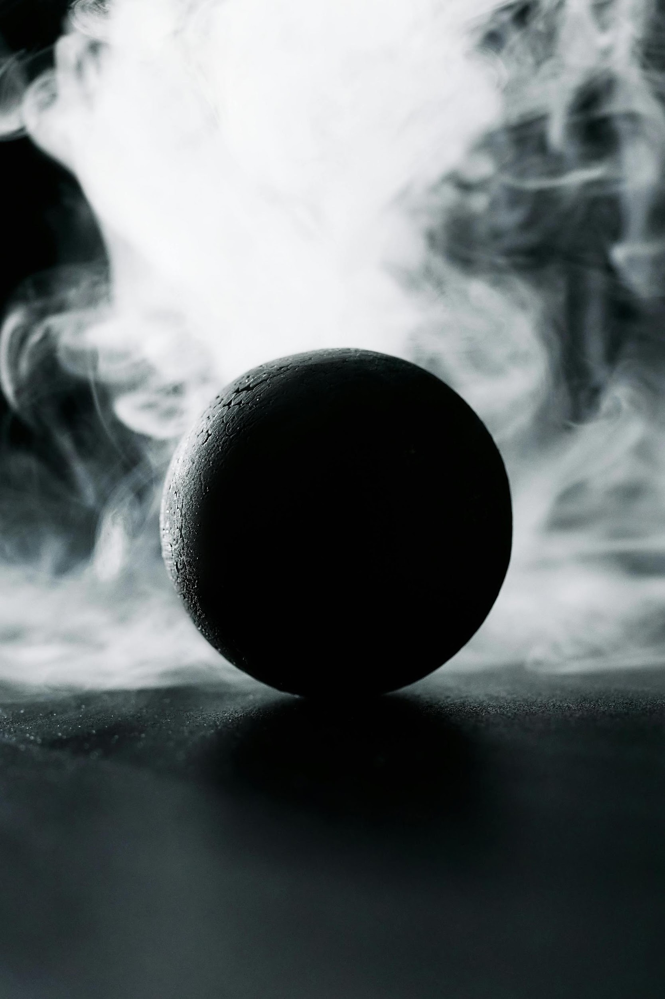
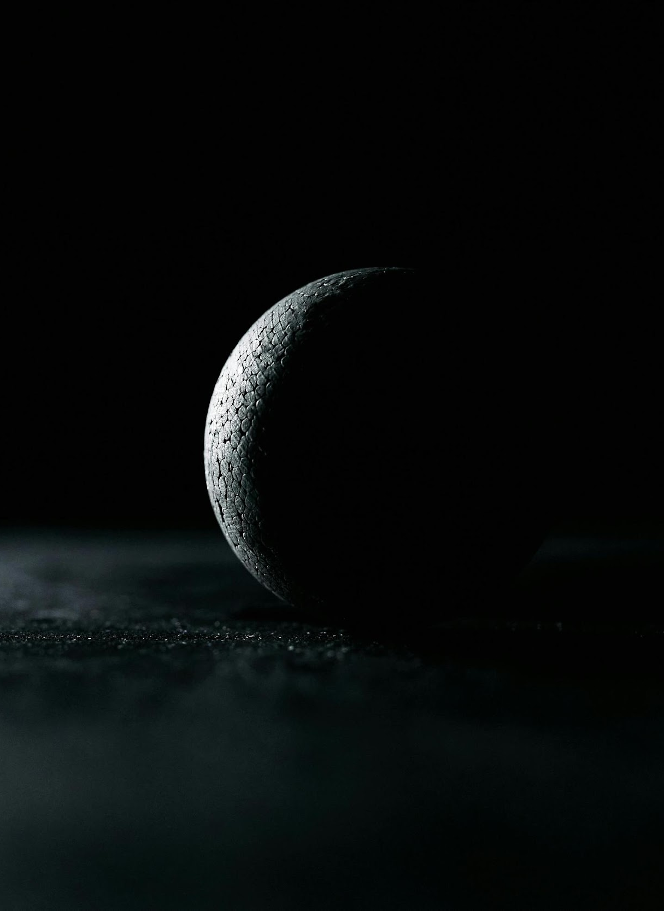
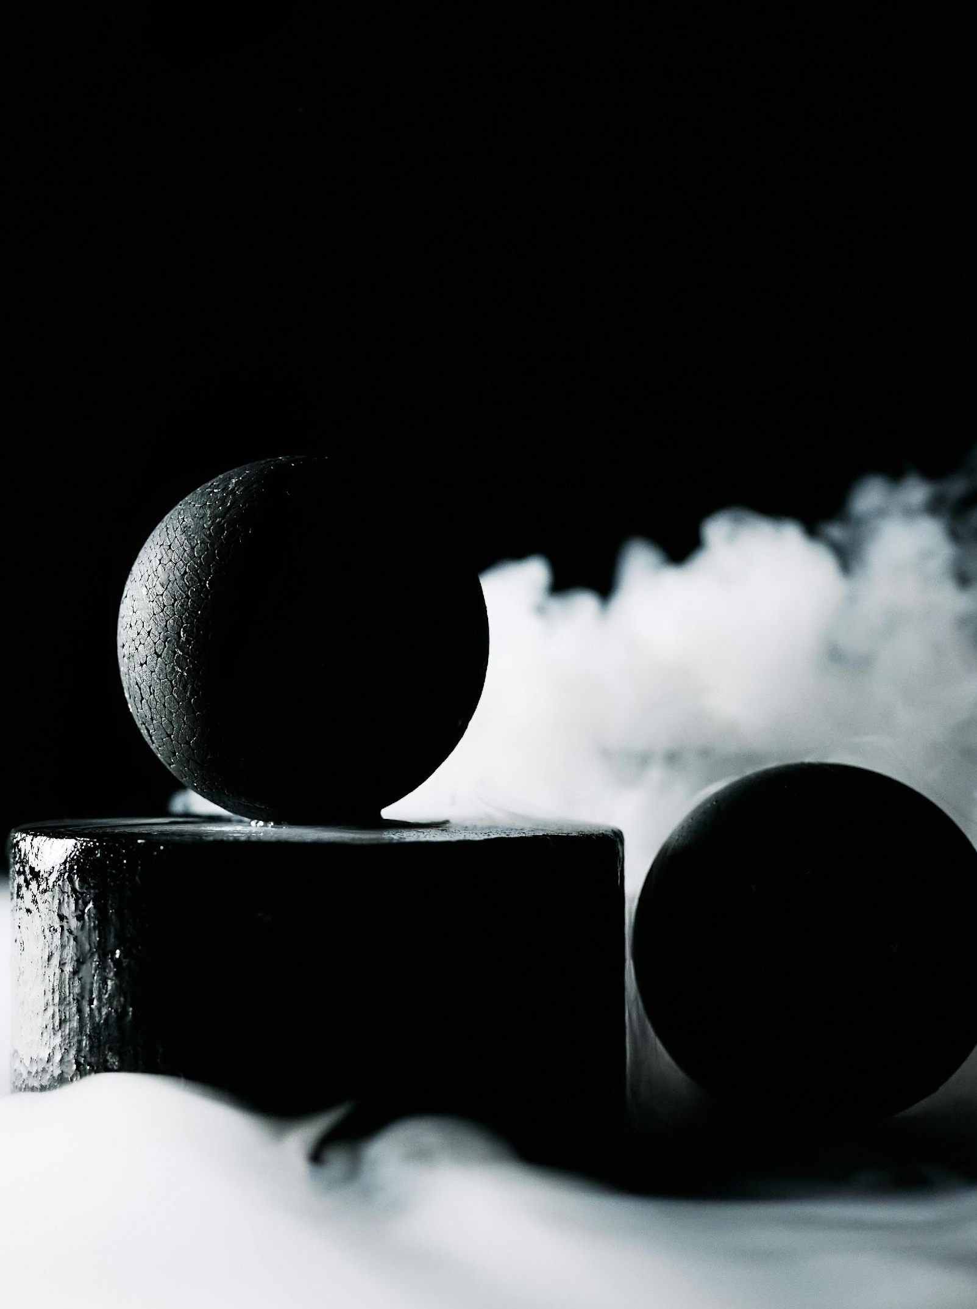
Importance of the light source
Photos by cottonbro studio: www.pexels.com

Slide 12

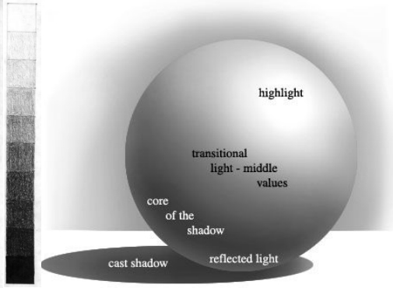
Tonal study of a sphere

Slide 13
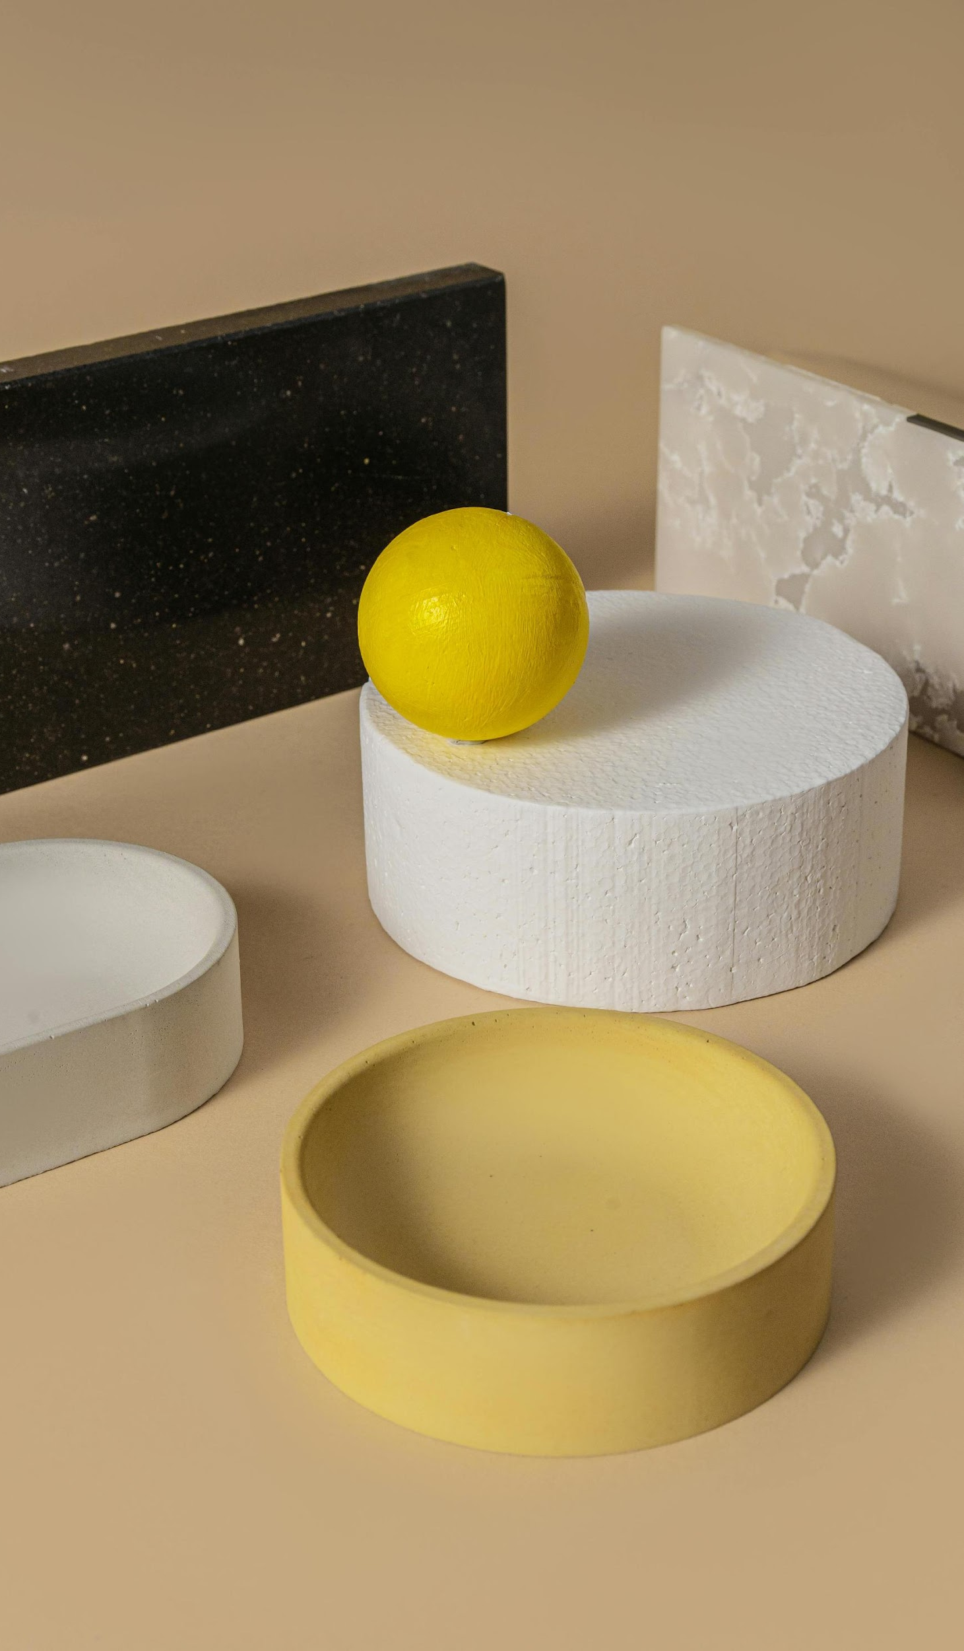

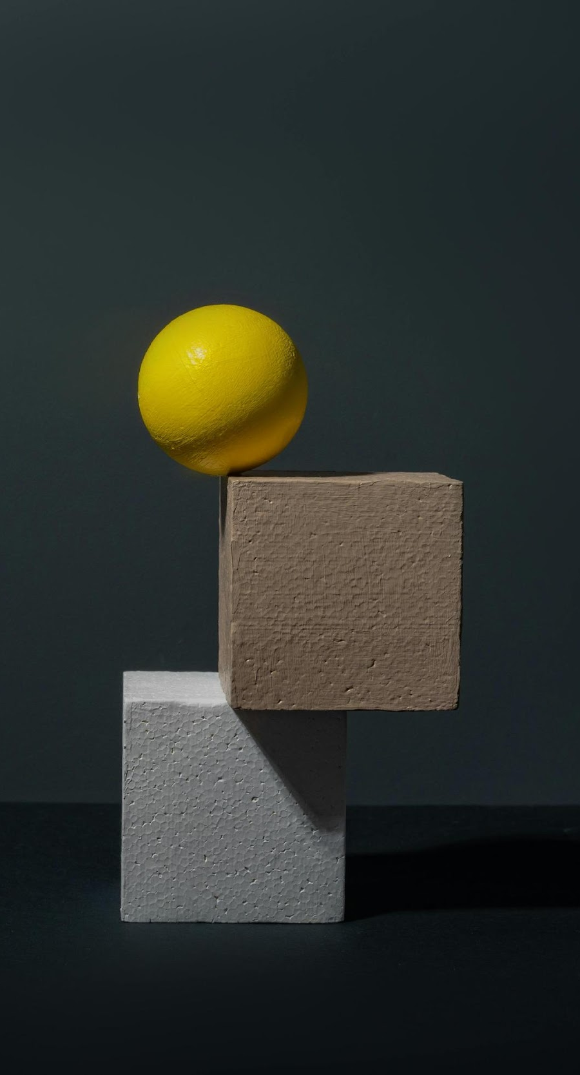
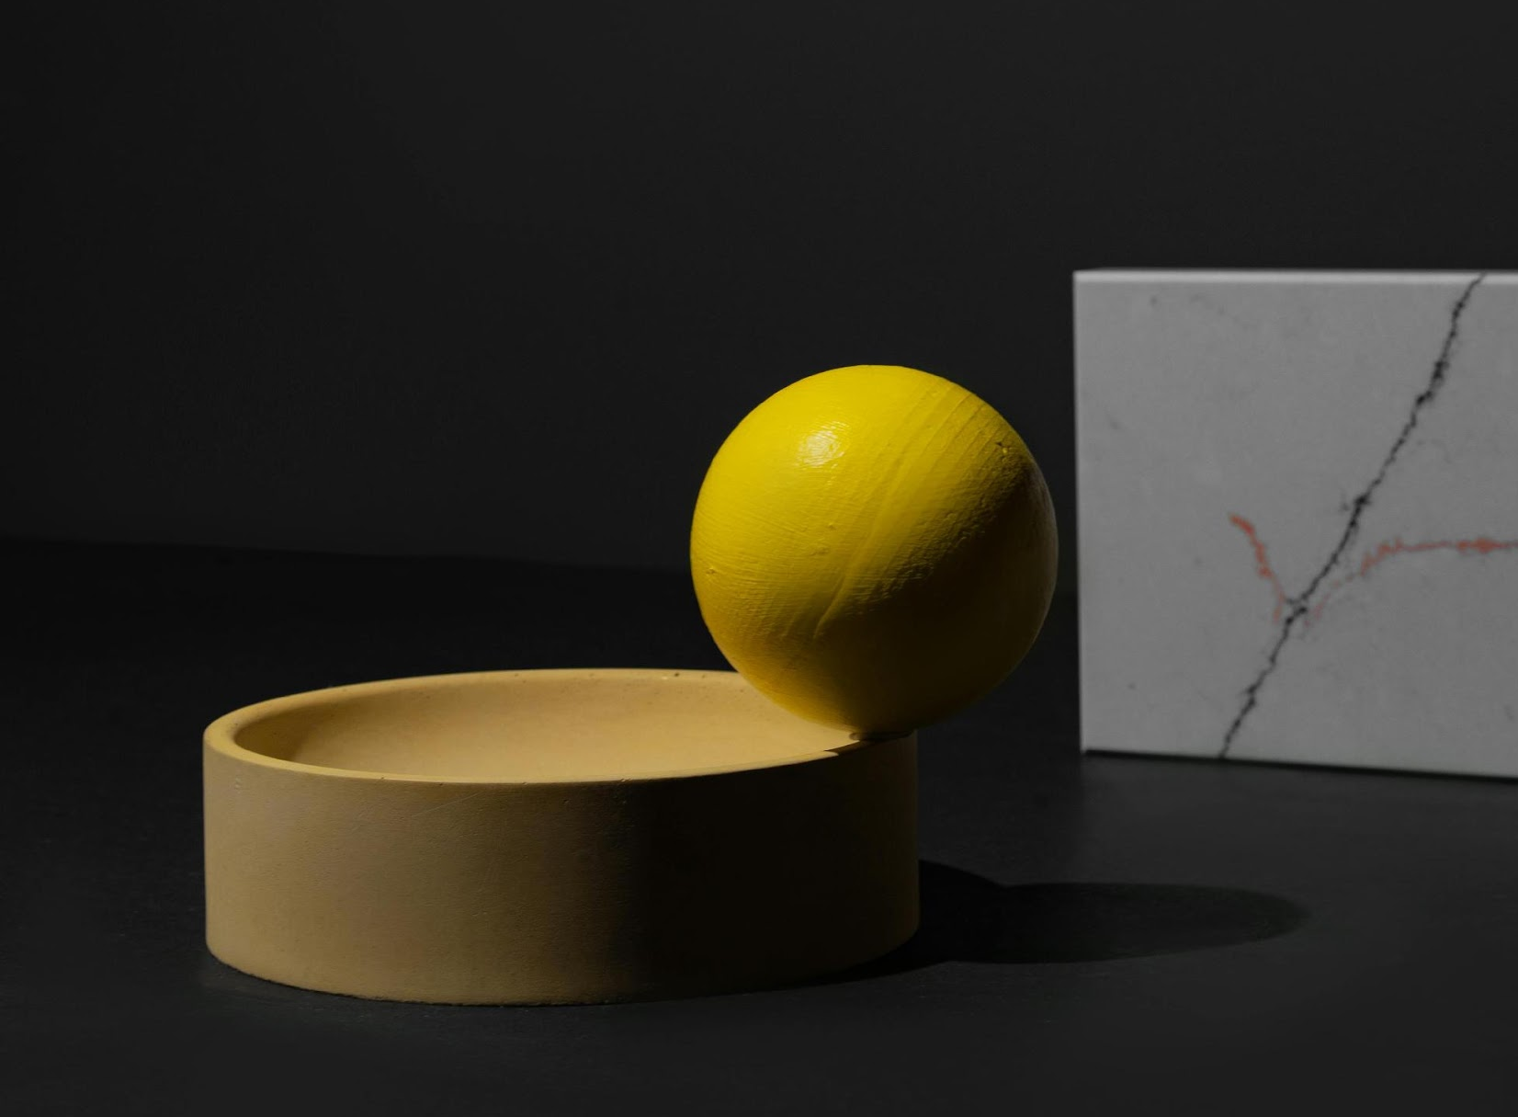
Examples of geometrical still life compositions

