Slide 1
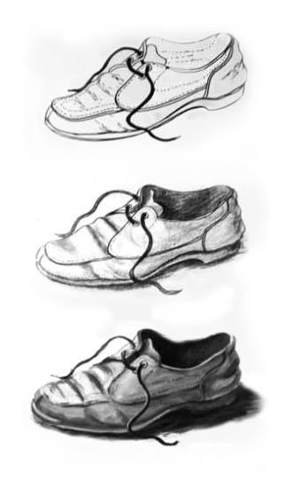
Elements of visual art
Line and tone
AS

Slide 2
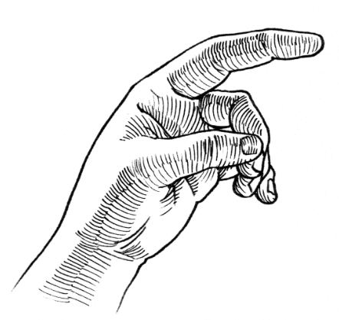
Objectives
Contour and shading
Shading and hatching
Know the techniques to create line/ contour drawings
Practice various ways of shading as you use lines
Line control technique
Learn to vary pressure and movement for expressive lines.

Slide 3
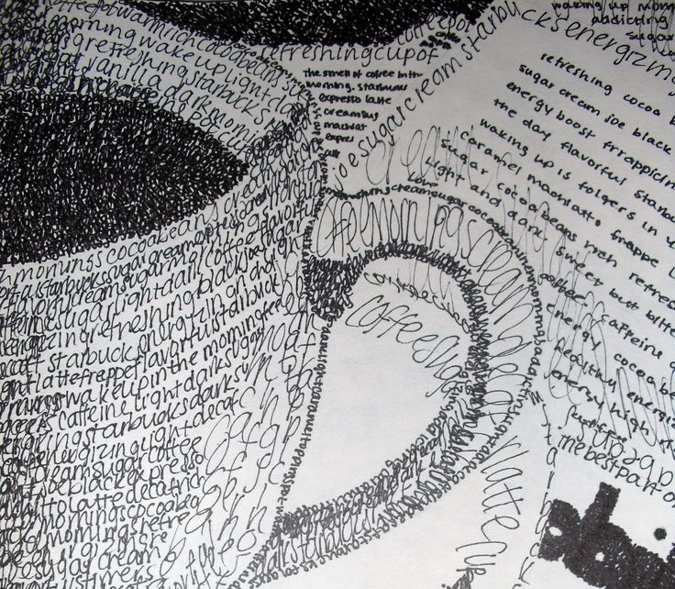
Techniques:
Mark making
Line quality: variation and control
Practice Exercises
Speed & Movement
Create straight, curved, zigzag, and organic lines daily.
Pressure Control
Slow, deliberate strokes vs fast, expressive marks.
Apply more pressure for thick lines, less for thin.

Slide 4
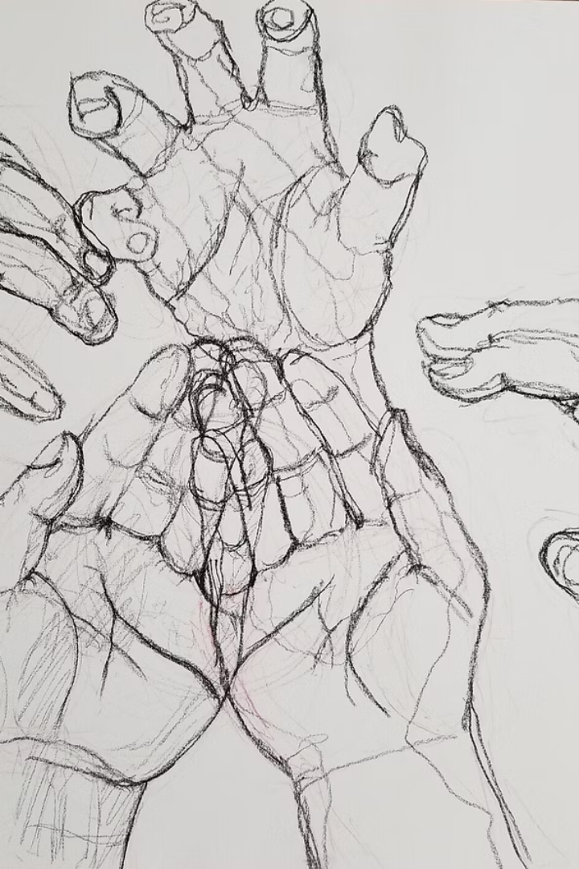



Line as expression: contour, gesture, hatching
Contour
Slow, careful outlines to capture edges and shape.
Gesture
Quick, loose lines capturing movement and energy.
Hatching
Lines created by drawing tools - they add texture and depth.

Slide 5
Linear vs Tonal Drawing Methods
Line and tone (value) are two major ways to create the drawing:
Linear Drawing
Tonal Drawing
Emphasizes outlines and distinct shapes, minimal shading.
Uses light and dark shades to create illusion of volume.

Slide 6
Drawing tools: what kind of shading you can create with them
Tools for Linear Drawing
Tools for Tonal Drawing
Graphite pencils
Hard core colored pencils
Pens (ink, fine-liners)
Charcoal pencils
Markers
Charcoal (vine or compressed)
Graphite pencils and sticks (H to 8B)
Pastels (soft, oil)
Soft colored pencils
Blending tools
Colored pencils
Graphite pencils (various hardness)
Charcoal and pastel pencils

Slide 7
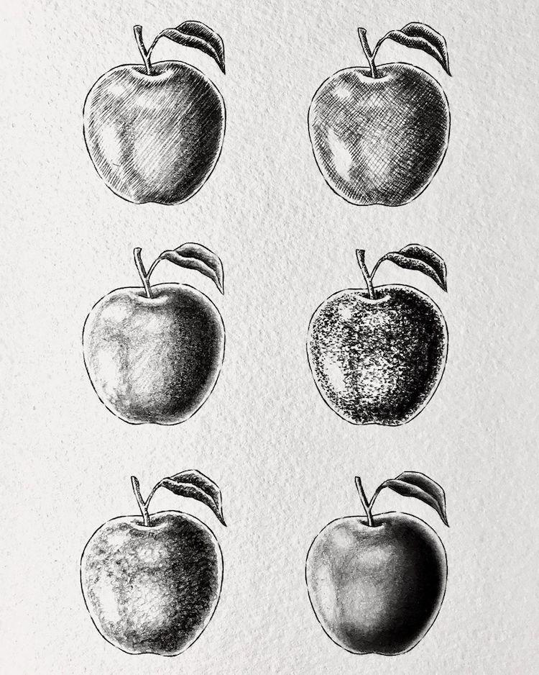
Main shading techniques.
Using line and even tone.
Parallel hatching
Scumbling
Stippling
Cross-hatching
Scribbling
Blending and smudging

Slide 8
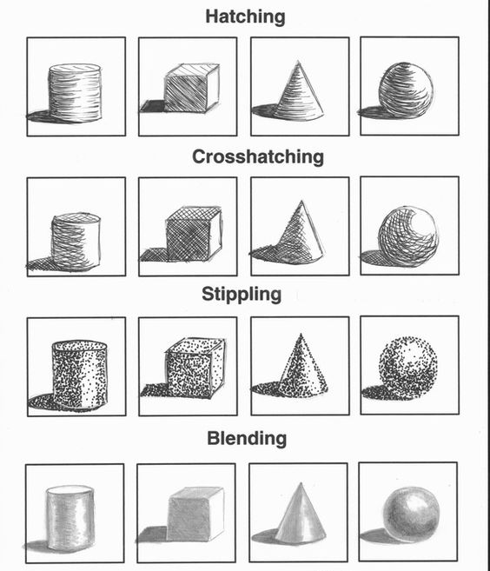
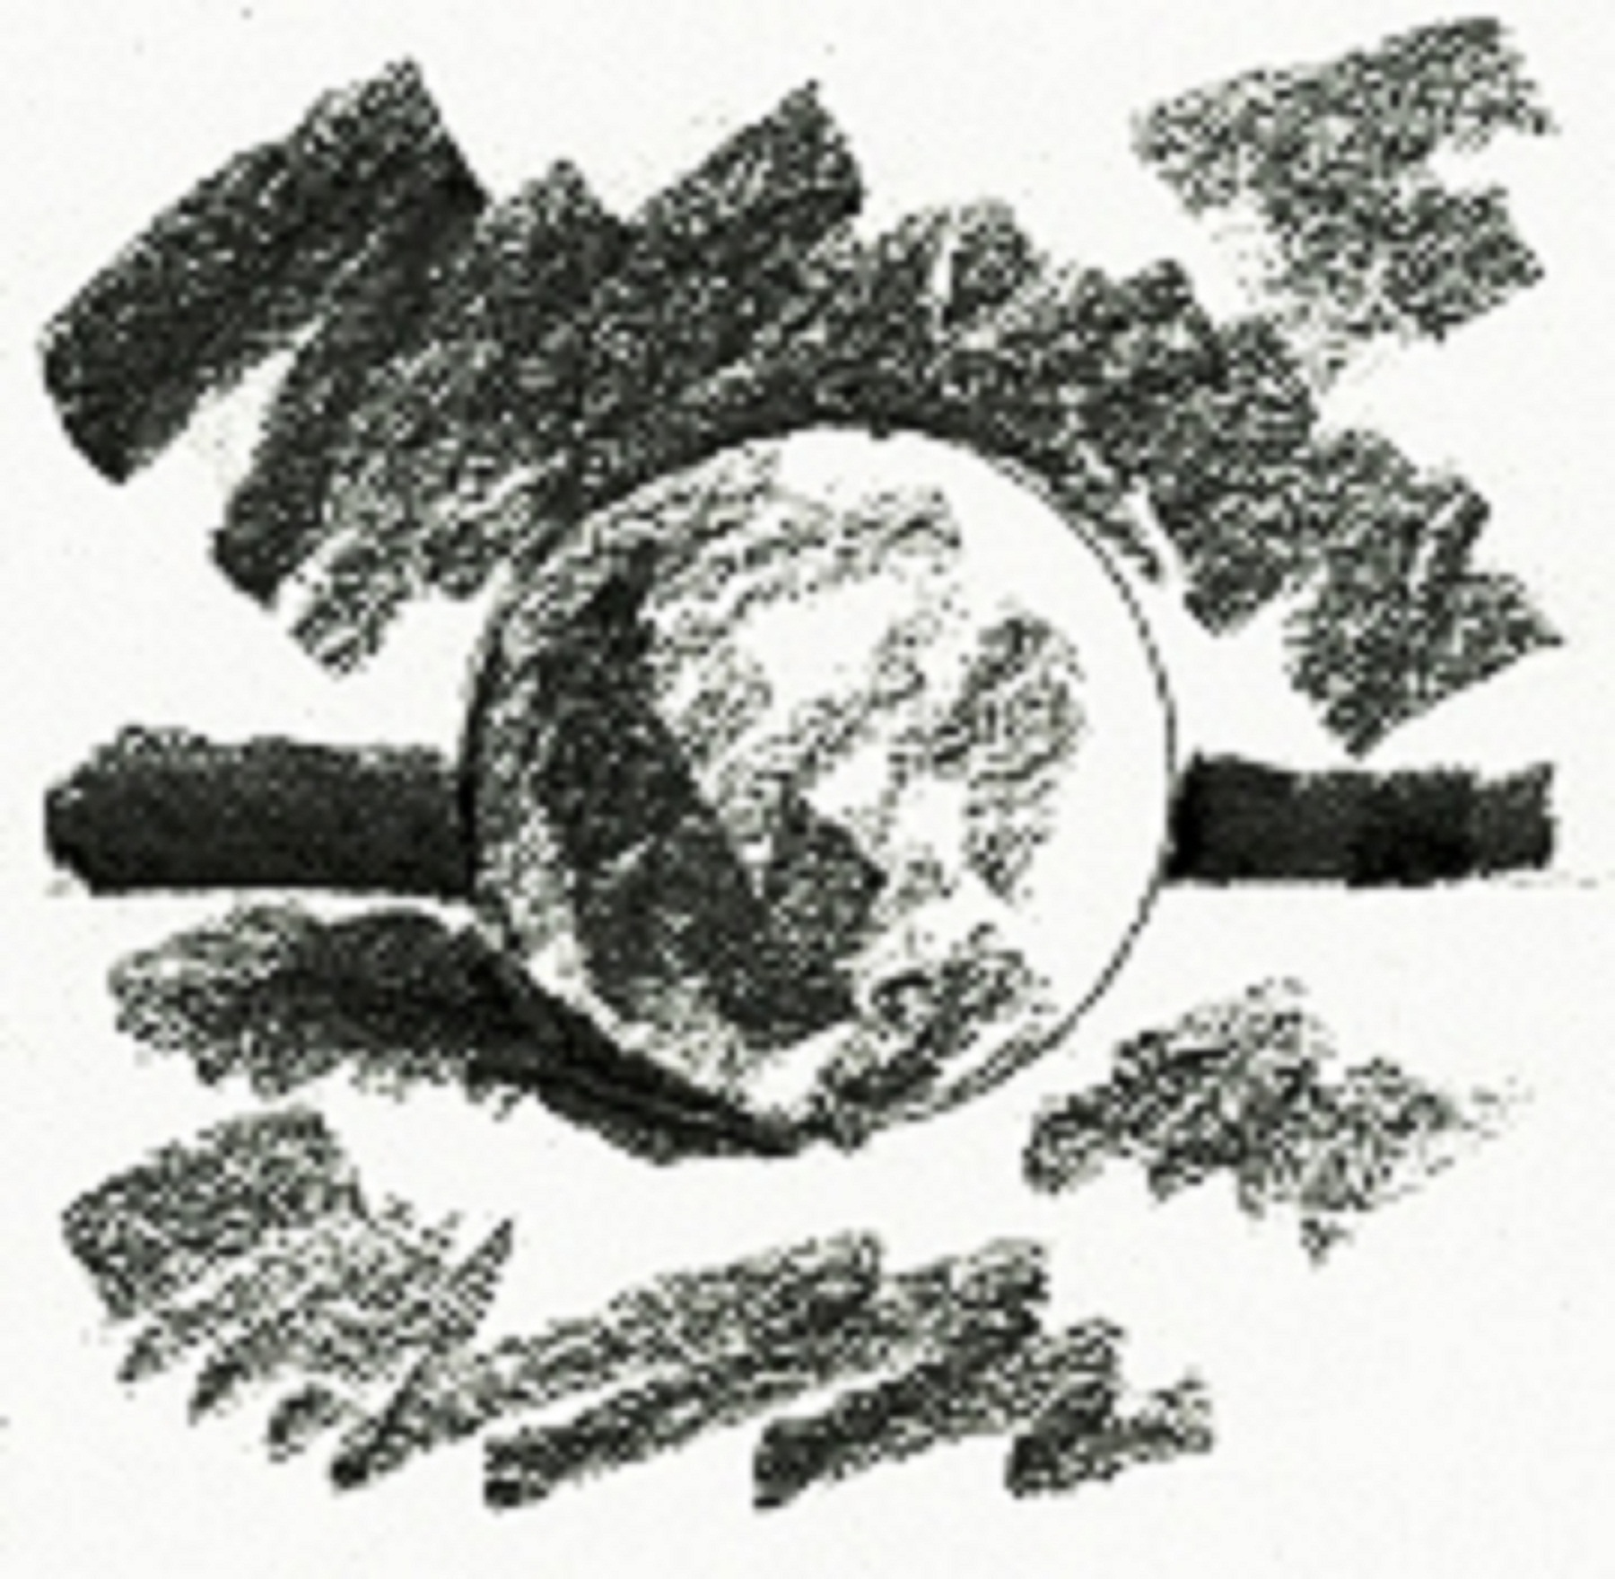
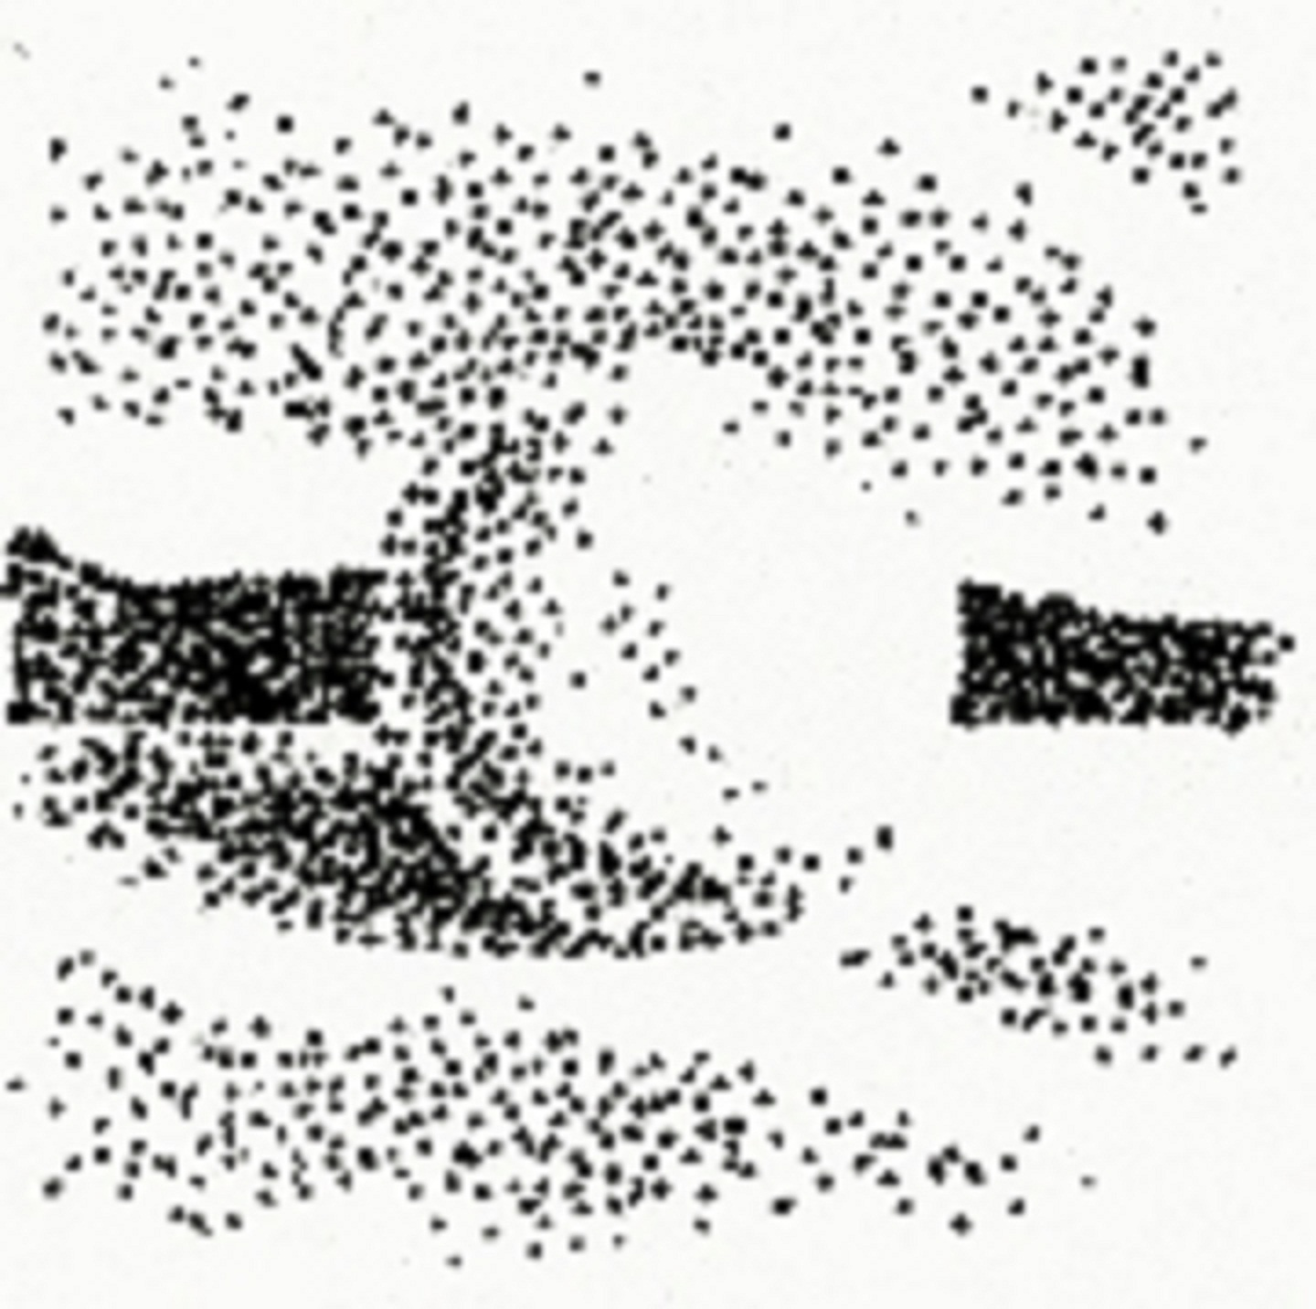
Different ways of shading geometric forms

Slide 9
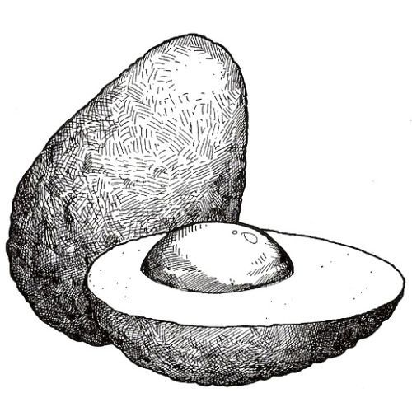
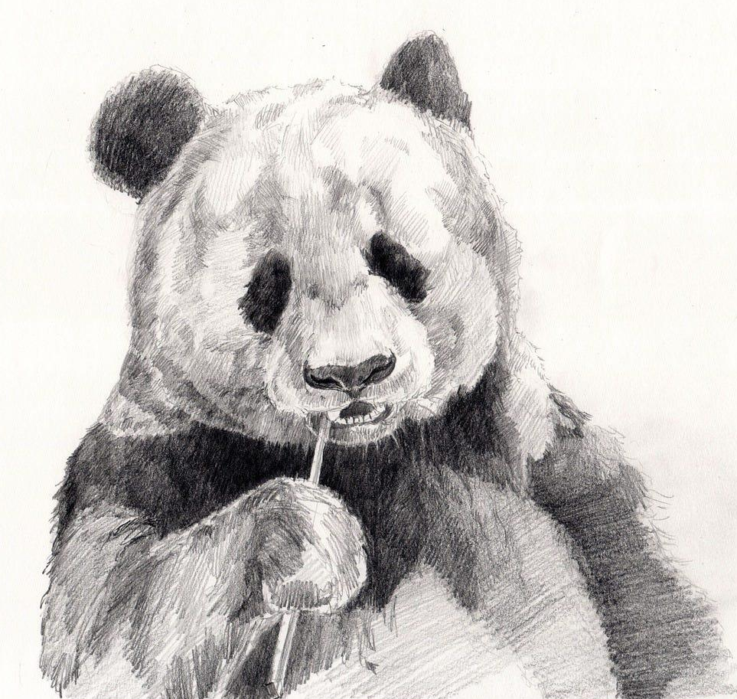
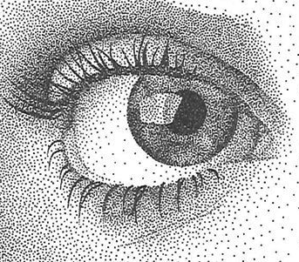
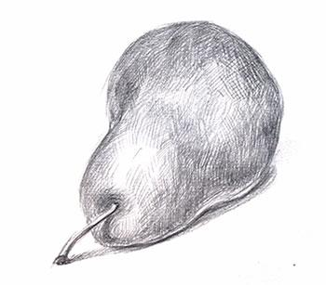
Different ways of shading in drawing real-life objects:
Cross-hatching
Stippling
Parallel line shading
Combination of parallel, contour and cross-hatching

Slide 10
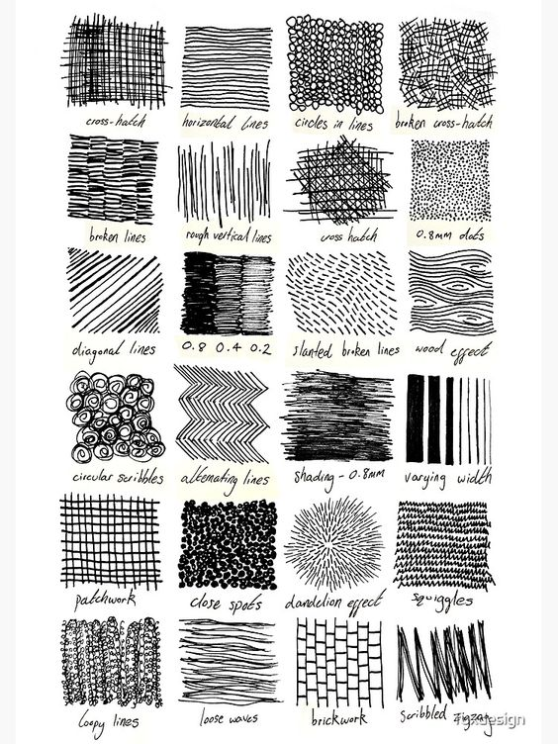
Other types of mark making
You can create quite a variety of textures and patterns with different marks. These drawings will not be looking absolutely realistic, but they still will convey the idea of space and depth.

Slide 11
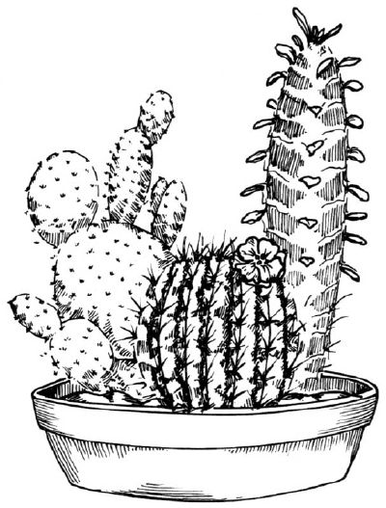
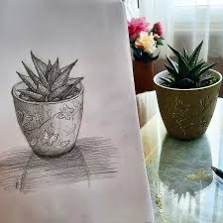
Project 1:
Linear drawing of a potted plant (cactus)
Reason for the choice
Simple subject with distinct shapes and details to practice drawing techniques with pencil lines.
Technique Application
Apply contour, gesture, and hatching in your sketch.
See also: Easy Cactus Drawing Tutorial

Slide 12
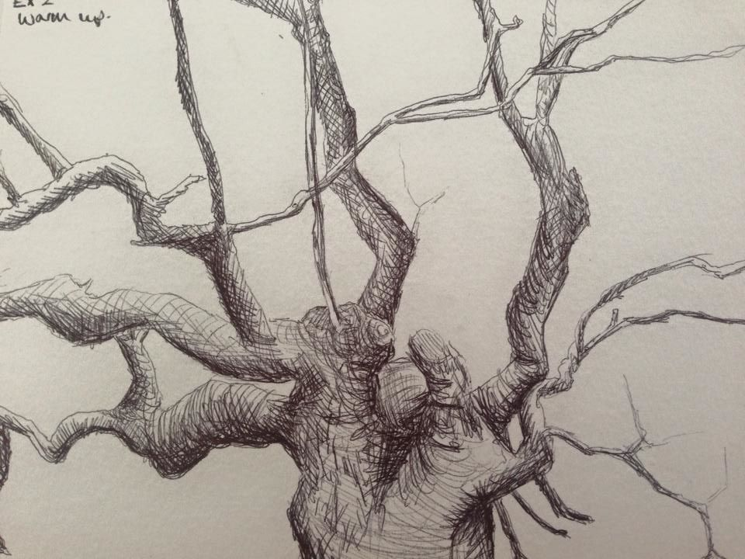
Project 2:
gesture sketches of natural objects
learn to draw through Nature journaling
Reason for the choice
Practice contour drawing; develop line sensitivity. Developing eye-hand coordination for drawing from observation.
Technique Application
Apply contour, gesture, and hatching in your sketch.
Example of nature sketch: chestnut sketch.jpeg
See also: What is Nature Journaling

